Slide 1
Biomedical Imaging X-Ray Imaging (II)
Sebastian Kozerke
Institute for Biomedical Engineering, University and ETH Zurich, Switzerland

Slide 2
Today’s Learning Objectives
Describe basic X-ray detection technologies
Relate image contrast to photon scattering
Explain encoding and decoding of projection data
Derive filtered back projection principle
Implement CT encoding and decoding (Exercise)

Slide 3
Resolution of imaging procedures
Chapter 1.5
Spatial resolution
Blurring of object points when projected into image
Contrast
Difference in linear attenuation coefficients between tissues
Temporal resolution
Sample rate of temporal recording

Slide 4
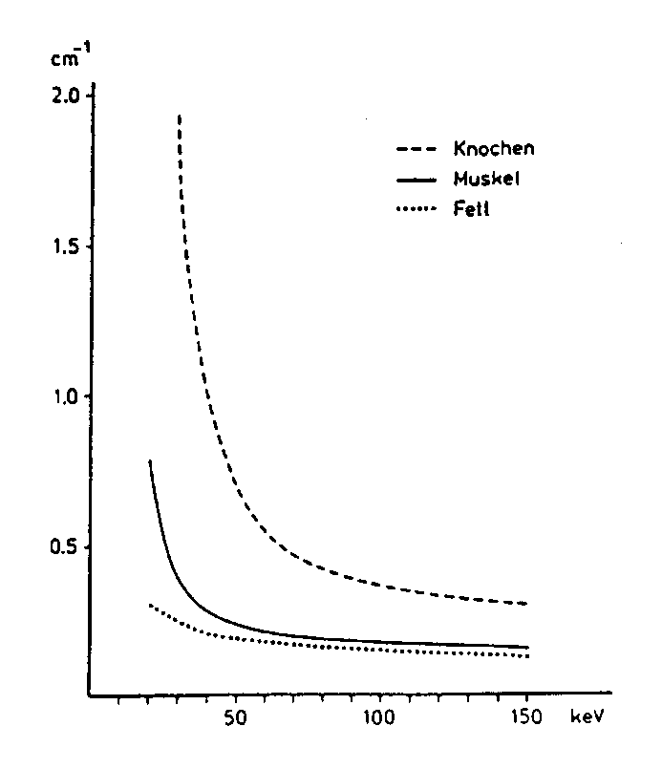
Resolution – Contrast
μ [cm⁻¹]
bone
muscle
fat
E [keV]
Notes:
Blackboard
-> scetch object with bone and soft tissue
-> illustrate weighted average of μ in case of heterogeneous composition along d

Slide 5
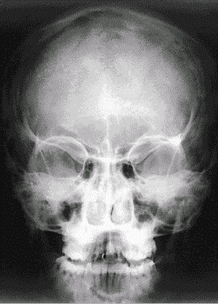
Resolution – Contrast
Large contrast between bone and tissue/air
Very little contrast among different tissues
Notes:
Blackboard
-> I/I₀=exp(-μd) -> display μ ~ -log(I/I₀)
-> calculate maximum contrast between air and average biological tissue with d = 20 cm (and μ=0.35 cm⁻¹ w/o bone or air): I/I₀ = exp(-μd) = exp(-7) = 1/1000
-> calculate maximum contrast between air and bone tissue with d = 20 cm (and μ=0.7 cm⁻¹): I/I₀ = exp(-μd) = exp(-14) = 8/10000000

Slide 6
Resolution of imaging procedures
Spatial resolution
Blurring of object points when projected into image
Contrast
Difference in linear attenuation coefficients between tissues
Temporal resolution
Sample rate of temporal recording

Slide 7
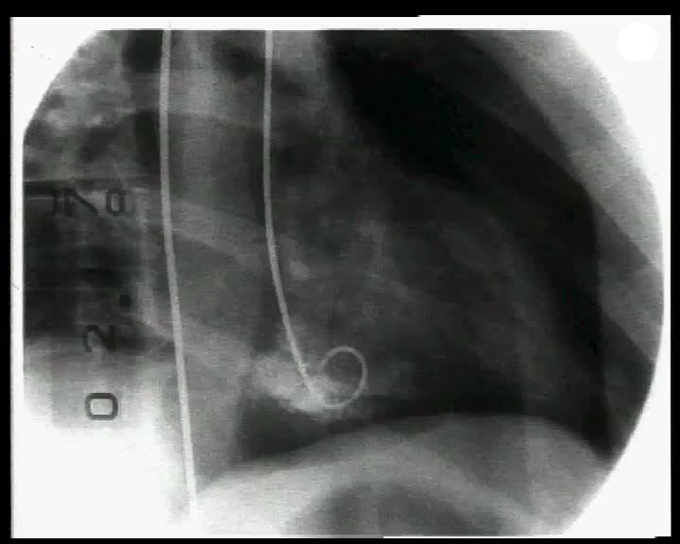
Resolution – Temporal resolution
Notes:
Blackboard
-> scetch ventricular volume as function of time + volume curve
-> scetch Fourier pair of volume curve: Δf = 1/T = 1 Hz

Slide 8
Chapter 2.6-2.7
Detector technology

Slide 9
Projection imaging – Photographic film
Double-sided film with intensifying screens
fluorescent screen #1 **)
film*)
carrier
fluorescent screen #2 **)
*) Silver halide (AgX): compound formed between silver and silver bromide (AgBr) or silver chloride (AgCl) or silver iodide (AgI).
**) Fluorescence increases efficiency about 5-fold but decreases resolution
Notes:
Blackboard
-> scetch thin and thick layer of AgX emulsion -> explain oblique incident radiation + scatter -> trade-off between layer thickness and absorption (-> Beer-Lambert)
-> scetch S = log(Opacity) as function of log(Exposure) -> linear range ΔS = 2.5

Slide 10
Projection imaging – Anti scatter grids
Film with anti-scatter grid
lead lamellae
Notes:
Blackboard
-> 1) scetch primary image (without scatter)
-> 2) scetch primary + scatter image (same image profile as in 1) but background signal larger)

Slide 11
Projection imaging – Image intensifier
incident radiation
scintillating screen + photocathode
e⁻
e⁻
e⁻
e⁻
e⁻
U_{DC}
photoanode + digital
output screen
Notes:
Notes
An X-ray image intensifier (XRII) refers to a special image intensifier device used in medical imaging involving x rays. It consists of an input window, input phosphor, photocathode, vacuum and electron optics, output phosphor and output window. It allows for lower x-ray doses to be used on patients by magnifying the intensity produced in the output image, enabling the viewer to easily see the structure of the object being imaged.

Slide 12
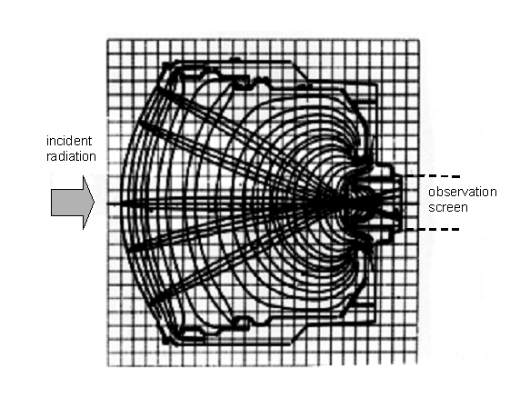
Projection imaging – Image intensifier
Notes:
Blackboard
-> scetch:
Input screen (CsI) -> Luminescence –> x-ray -> photon
Photokathode -> photons -> electrons get accelerated

Slide 13
Projection imaging – Summary
Particle statistics in a typical X-ray chain
incident radiation
object (photons)
2⋅10⁶
incident radiation
image intensifyer screen
2⋅10³
absorption efficiency
image intensifyer screen
10³
light (photons)
image intensifyer screen
5⋅10⁶
electrons
image intensifyer screen
10⁵
light (photons)
image intensifyer exit screen
10⁹
102 104 106 108 1010
nr. of particles per mm² and 40 msec

Slide 14
Chapter 2.6-2.7
Digital X-ray

Slide 15
Image conversion
Luminescence using barium fluorohalide (BaFBr:Eu)
1)
2)
3)
PMT
incident radiation
conduction band
red laser
e⁻
e⁻
BaFBr⋅Eu
valence band
absorbed x-rays liberate e- from valence band to conduction band; e⁻ get trapped
scanning red laser stimulates trapped electrons
reflected light is collected in photo multiplier tube + stored as digital image
Notes:
Notes
In semiconductors and insulators, there is a bandgap above the valence band, followed by a conduction band above that.
In metals, the conduction band has no energy gap separating it from the valence band. The rest of this article refers to the valence band in semiconductors and insulators.
PMT = Photo Multiplier Tube

Slide 16
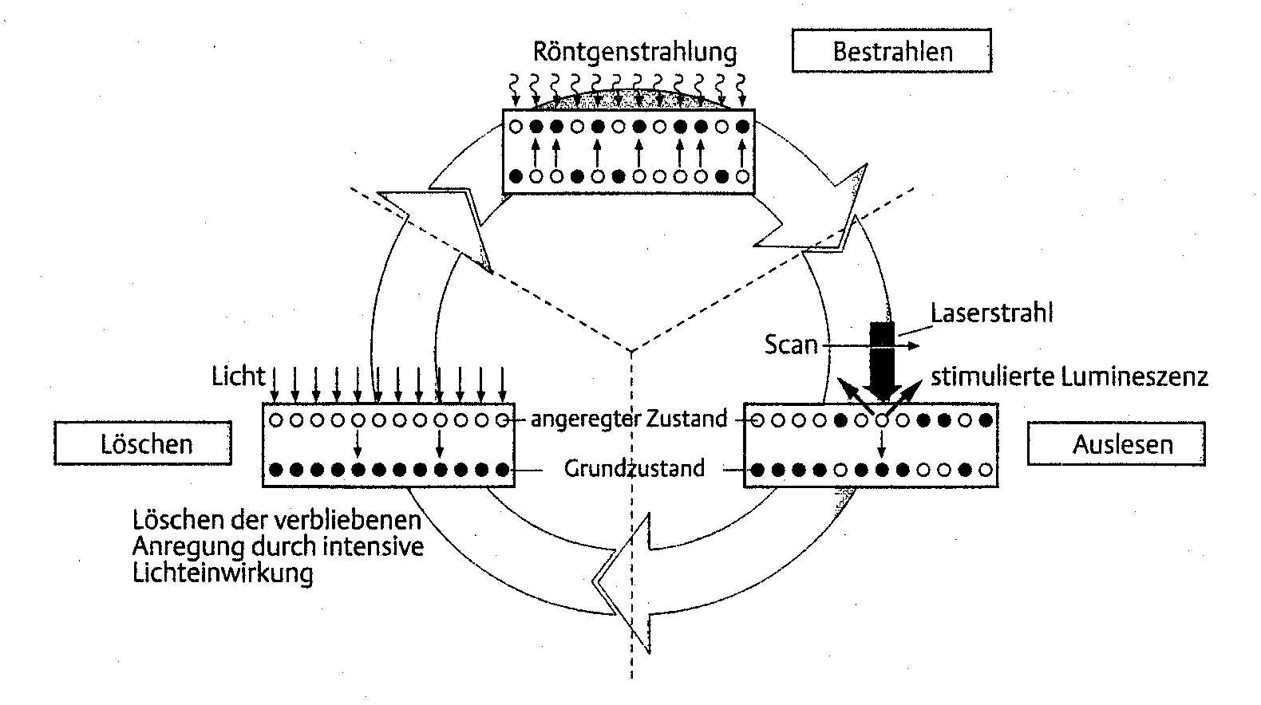
Digital Luminescence
incident radiation
exposure
laser beam
light
scan
stimulated luminescence
excited state
ground state
reset
read-out
remaining excitation
is removed by exposure
to intensive light
Ba F Br: Eu++
Notes:
Notes
The method makes use of electrons trapped between the valence and electron band in the crystaline structure of matter. Aluminum oxide is one such type of matter. The trapping sites are imperfections of the lattice - impurities or defects. The ionizing radiation produces electron-hole pairs - electrons are in the conduction band and holes in the valence band. The electrons which have been excited to the conduction band may become trapped in traps present. Under stimulation of light the electrons may free themselves from the trap and get into the conduction band. From the conduction band they may recombine with holes trapped in hole traps. If the centre with the hole is a luminescence centre emission of light will occur. The photons are detected using a photomultiplier tube. The signal from the tube is then used to calculate the dose that the material had absorbed.

Slide 17
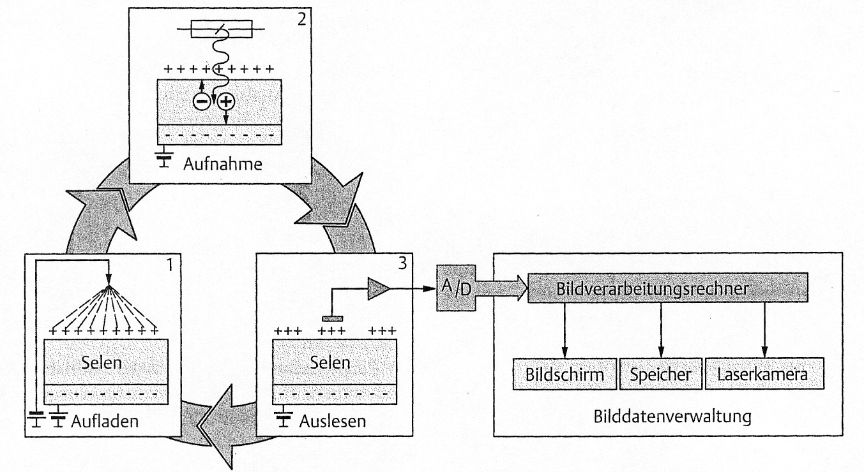
Selenium Detector
exposure
computer
selenium
selenium
viewing storage imaging
(laser camera)
charge
read-out
Notes:
Notes
Surface of selenium detector is charged
X-ray photons liberate electrons in the centre which neutralize surface charges
Surface potential is read

Slide 18
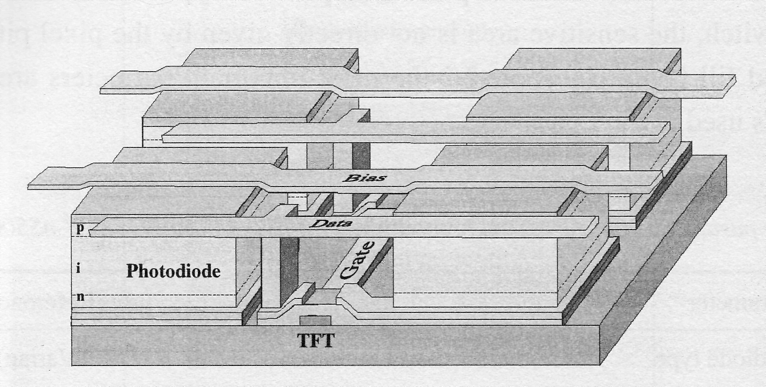
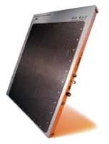
Silicium Detector

Slide 19
Scintillation Detector
Notes:
Notes
A scintillator is a or substance that absorbs high energy (ionizing) electromagnetic or charged particle radiation then, in response, fluoresces photons at a characteristic Stokes-shifted (longer) wavelength, releasing the previously absorbed energy. See also Scintillation (physics). Scintillators are defined by their light output (number of emitted photons per unit absorbed energy), short fluorescence decay times, and optical transparency at wavelengths of their own specific emission energy. The latter two characteristics set them apart from phosphors. The lower the decay time of a scintillator, that is, the shorter the duration of its flashes of fluorescence are, the less so-called "dead time" the detector will have and the more ionizing events per unit of time it will be able to detect.
Scintillators are used in many physics research applications to detect electromagnetic waves or particles. There, a scintillator converts the energy to light of a wavelength which can be detected by inexpensive or easy to handle detectors such as photomultiplier tubes (PMTs).

Slide 20
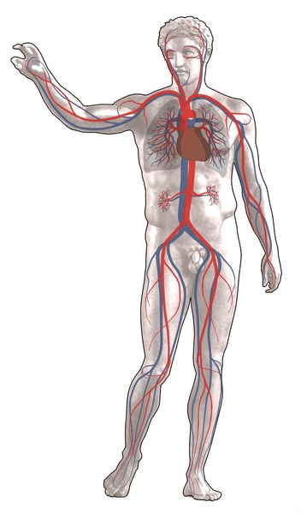
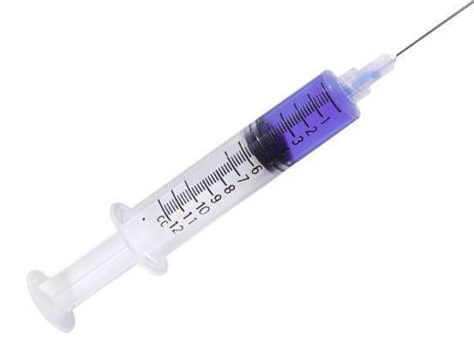
Contrast agent
Chapter 2.9
Absorption
Time
Iodine contrast media to increase x-ray absorption

Slide 21
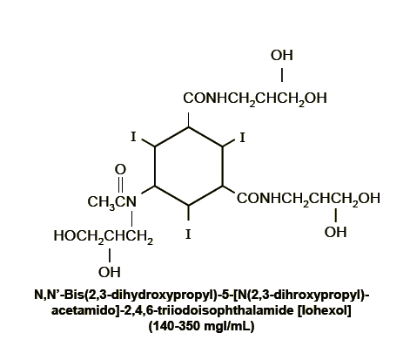
Contrast agent

Slide 22
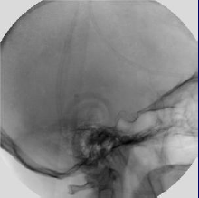
Digital Subtraction
Chapter 2.10
pre-contrast
post-contrast
difference+enhancement
difference

Slide 23
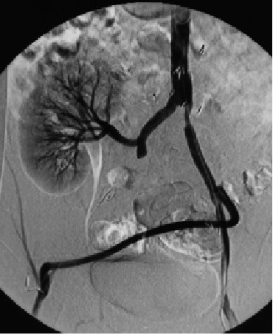
DSA Angiography

Slide 24
Real-time DSA Angiography

Slide 25
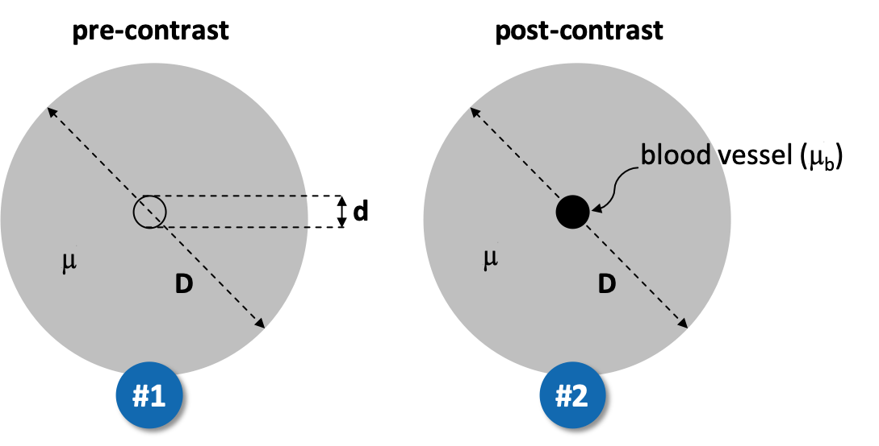


Clicker Activity (5 min)
Digital Subtraction Angiography is performed including a pre-contrast measurement #1 and a post-contrast measurement #2. The contrast agent increases the linear attenuation coefficient in blood. What is the image contrast of projection through the center point of the setup?
• Contrast ~ (μ_{b}*d - μ*D)
• Contrast ~ (μ_{b} *D - μ *d)
• Contrast ~ (μ_{b} - μ)*d
?

Slide 26
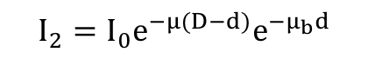
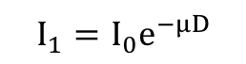
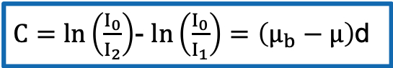
Clicker Activity (Notes)
pre-contrast
post-contrast
blood vessel (m_{b})
d
m
m
D
D
#1
#2
$$I_{1}=I_{0}e^{−μD}$$
$$I_{2}=I_{0}e^{−μ(D−d)}e^{−μ_{b}d}$$
$C=ln\left(\frac{I_{0}}{I_{2}}\right)$- $ln\left(\frac{I_{0}}{I_{1}}\right)=\left(μ_{b}−μ\right)$d

Slide 27
Chapter 2.12
Computed Tomography

Slide 28
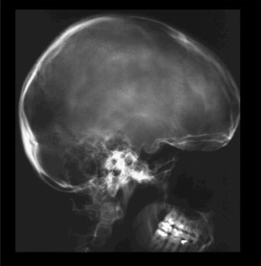
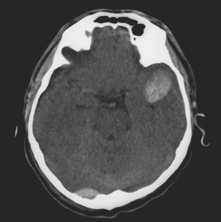
Problem
Adapted from Kalender WA, Computed Tomography, ISBN 3-89578-216-5

Slide 29
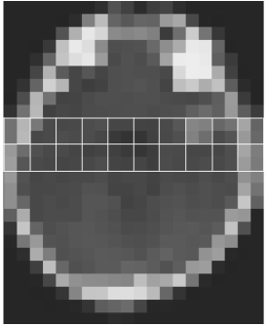
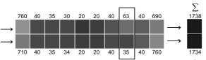
Problem
I₁
I₂
Adapted from Kalender WA, Computed Tomography, ISBN 3-89578-216-5
Notes:
Blackboard
-> calculate contrast in a) projection imaging (=(1738-1734)/3472 = 0.01%) vs b) tomographic imaging (=(63-35)/98 = 28%)

Slide 30
Projection versus Tomographic imaging
Projection imaging
= 3D structures are collapsed onto 2D image:
- details are obscured - low soft-tissue contrast - not quantitative
Tomographic imaging
= 3D structure is resolved:
- slices (“gr: Tomos = slice”)
- Computed image reconstruction
- Projection imaging and CT share same principles of x-ray generation, interaction, detection

Slide 31
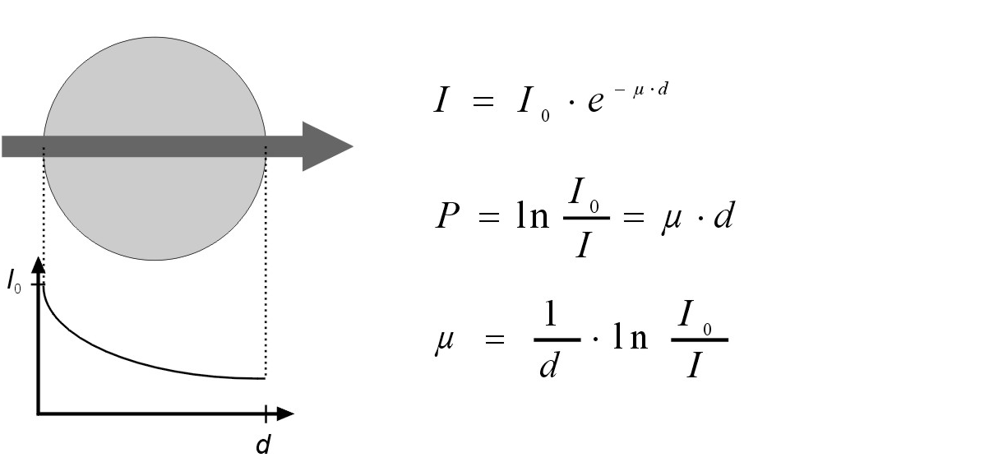
CT – Reconstruction problem
Chapter 1.10,2.14
1) Homogeneous object, monochromatic radiation
Adapted from Kalender WA, Computed Tomography, ISBN 3-89578-216-5

Slide 32
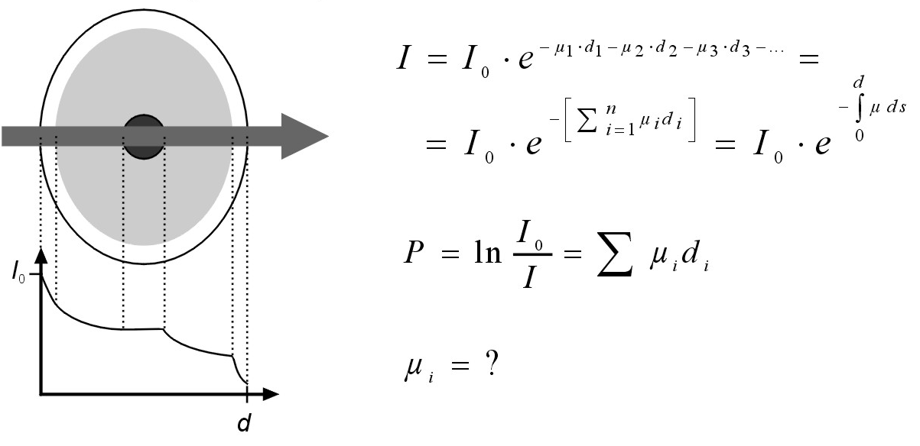
CT – Reconstruction problem
2) Inhomogeneous object, monochromatic radiation
Adapted from Kalender WA, Computed Tomography, ISBN 3-89578-216-5

Slide 33
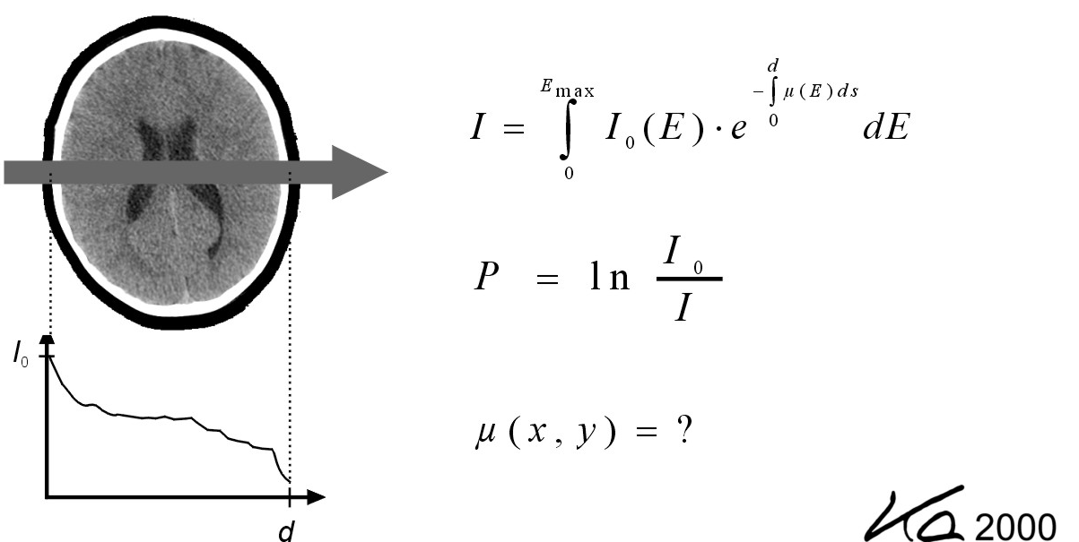
CT – Reconstruction problem
3) Inhomogeneous object, polychromatic radiation
Adapted from Kalender WA, Computed Tomography, ISBN 3-89578-216-5

Slide 34
CT – History
Johann Radon, 1917
- mathematical foundation for tomographic image reconstruction
Allan Cormack, 1963
- first experiments with axial tomography
Godfrey Hounsfield, 1972
- first clinical prototype; manufactured at EMI Ltd., England
(Cormack and Hounsfield shared Nobel prize in 1979)
Notes:
Notes
Johann Radon (December 16, 1887–May 25, 1956) was a mathematician born in Litoměřice in Bohemia (now Czech Republic). He wrote a doctoral dissertation on calculus of variations in 1910, at the University of Vienna.
Allan MacLeod Cormack (February 23, 1924 – May 7, 1998) was a South African-born American physicist who shared a part of the 1979 Nobel Prize in Physiology or Medicine for his work on the computerized axial tomography (CAT) scan.
Sir Godfrey Newbold Hounsfield CBE (28 August 1919 – 12 August 2004) was an English electrical engineer who shared the 1979 Nobel Prize for Physiology or Medicine with Allan McLeod Cormack for his part in developing the diagnostic technique of computerized axial tomography (CAT).His name is immortalised in the Hounsfield scale, a quantitative measure of radiodensity used in evaluating CAT scans. The scale is defined in Hounsfield units (symbol HF), running from air at -1000 HF, through water at 0 HF, and up to bone at +1000 HF.

Slide 35
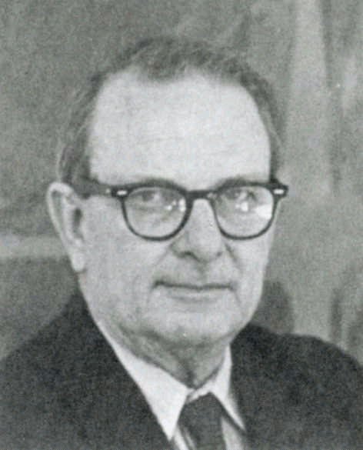
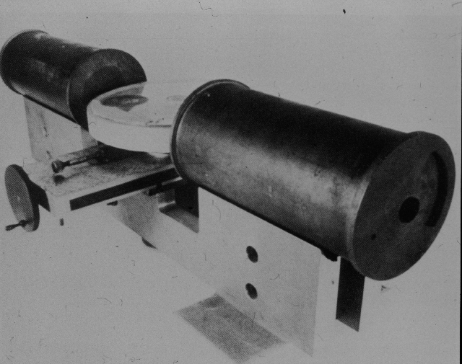
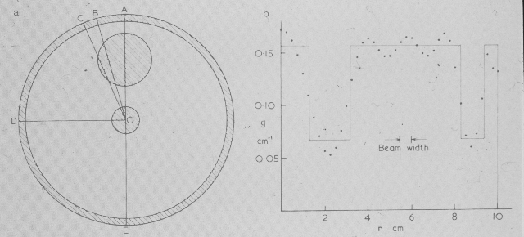
CT – Allan Cormack

Slide 36
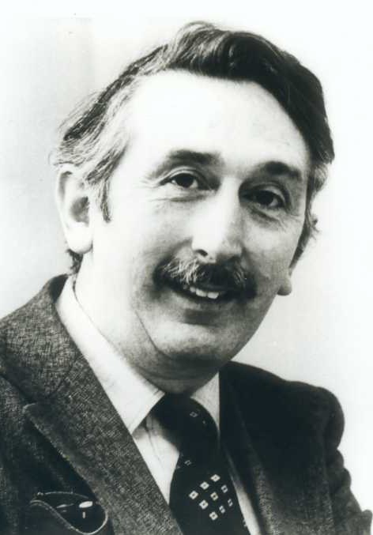
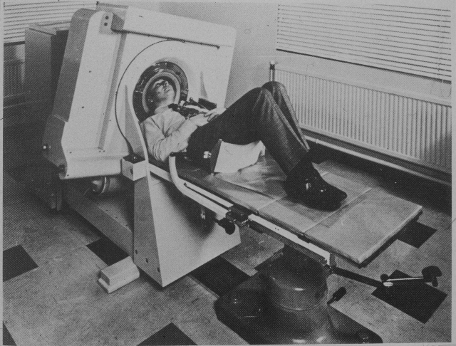
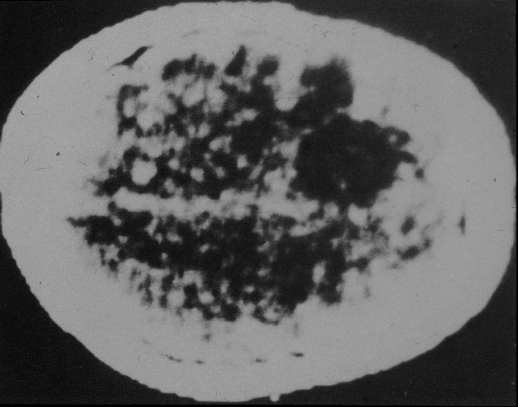
CT – Godfrey Hounsfield

Slide 37
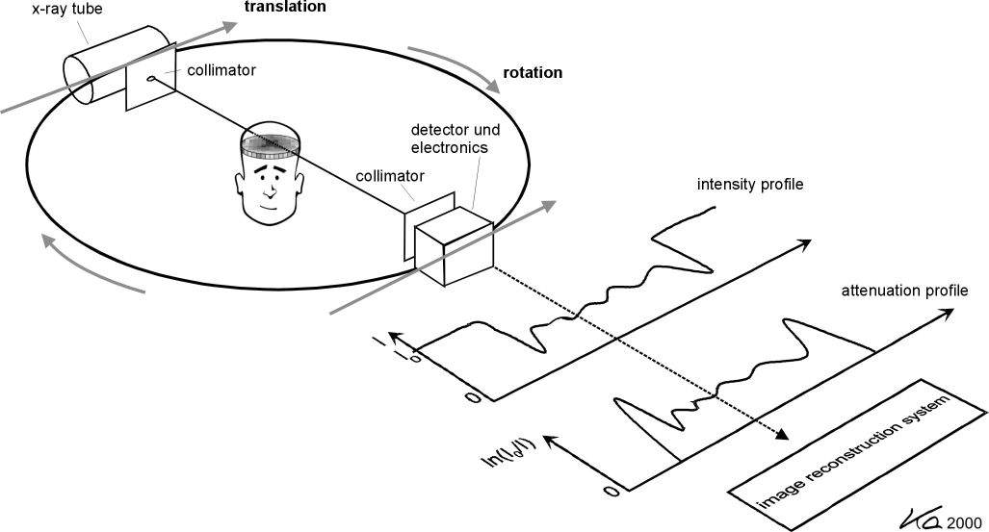
CT – Principle
Adapted from Kalender WA, Computed Tomography, ISBN 3-89578-216-5

Slide 38
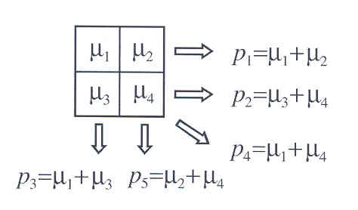
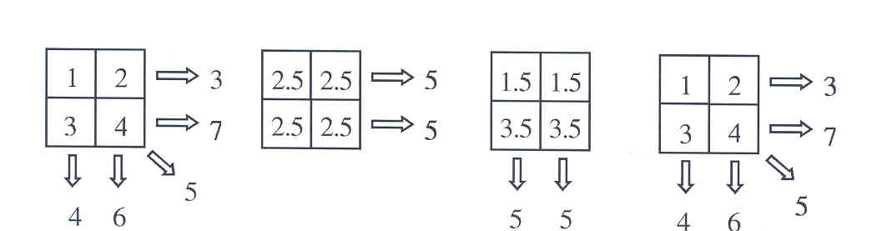
CT – Image reconstruction
Direct inversion (solving N unknowns from at least N equations)
Iterative reconstruction
1.
2.
3.
4.
(image estimation, pseudo-projection, minimization of residuum)

Slide 39
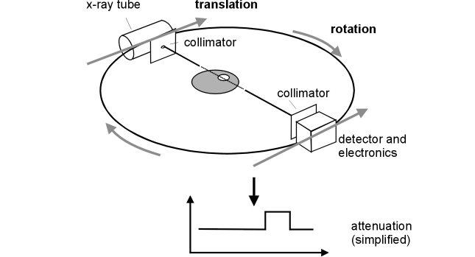
CT – Image reconstruction
Backprojection
Adapted from Kalender WA, Computed Tomography, ISBN 3-89578-216-5

Slide 40
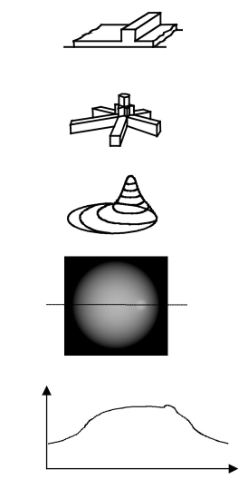
CT – Image reconstruction
Backprojection
1 projection
3 projections
N projections
Image
Adapted from Kalender WA, Computed Tomography, ISBN 3-89578-216-5

Slide 41
CT – Image reconstruction
Backprojection – Point Spread Function (PSF)
Point object
Image
PSF is obtained if 1) radius_{object} → 0
2) number of projections → ∞
3) number samples per projection → ∞

Slide 42

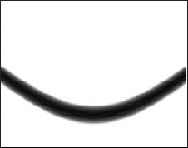
CT – Image reconstruction
Radon transform
y
“Sinogram”
Source
r
y
ϕ
r
x
xcosϕ + ysinϕ = 0
x
ϕ
Detector
Radon transform = Image encoding principle in CT
Notes:
Blackboard
-> illustrate R[μ] for ϕ=[0,45,90deg]

Slide 43


Clicker Activity (5 min)
Which object does the sinogram below correspond to?
• Object #1
• Object #2
• Object #3
0
r
?
0
90°
180°
φ
1
2
3
y
x

Slide 44
CT – Image reconstruction
Inverse transform (I)
“Wanted”
Radon found analytical solution but it’s numerically impractical
“Use Fourier transform”
Notes:
Blackboard
-> illustrate coordinate systems [x,y] -> [p,q] and [r,s] -> [u,v]

Slide 45
CT – Image reconstruction
Inverse transform (II)
Reconstruction formula
Notes:
Blackboard
-> p = u cosϕ, q = u sinϕ
-> dpdq = u du dϕ

Slide 46
CT – Image reconstruction
Inverse transform (III)
F{Pϕ (u)} is weighted by |u|
F{Pϕ (u)} |u| is inversely transformed
and summed over all angles ϕ (=backprojection)
Notes:
Blackboard
-> r = x cosϕ + y sinϕ
-> F{P(u,ϕ+π)} = F{P(-u,ϕ)}

Slide 47
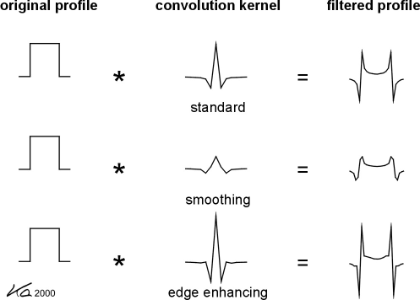
CT – Image reconstruction
Convolution backprojection
Adapted from Kalender WA, Computed Tomography, ISBN 3-89578-216-5

Slide 48
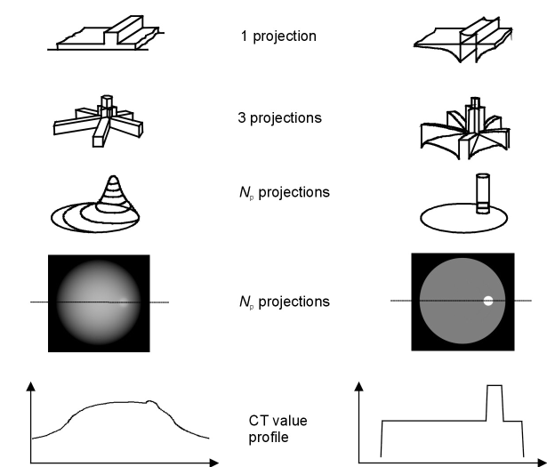
CT – Image reconstruction
without pre-filtering
with pre-filtering
Adapted from Kalender WA, Computed Tomography, ISBN 3-89578-216-5

Slide 49

CT – Image reconstruction
Convolution backprojection process
From Kalender WA, Computed Tomography, ISBN 3-89578-216-5

Slide 50
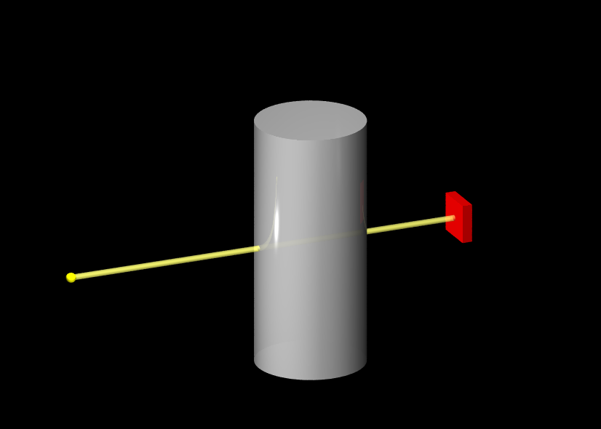
CT – Pencil beam
Object
Detector
X-ray
Source

Slide 51
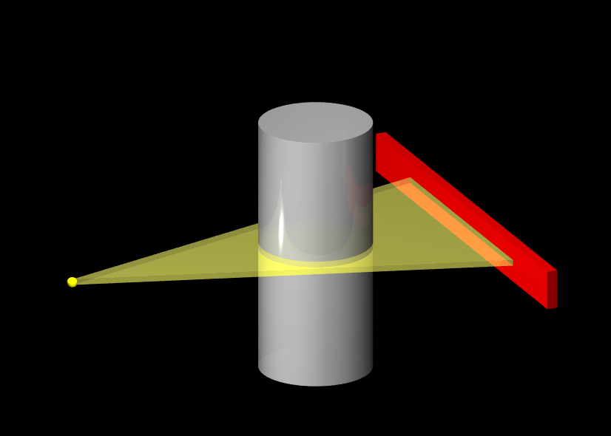
CT – Fan beam

Slide 52
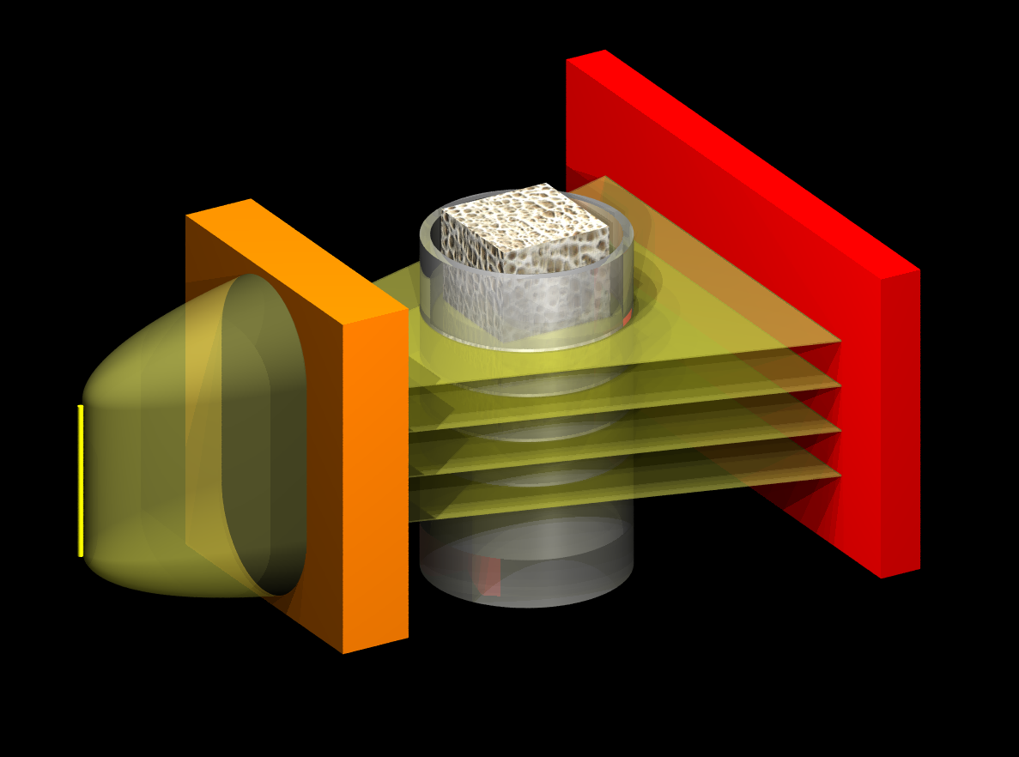
CT – Parallel fan beam

Slide 53
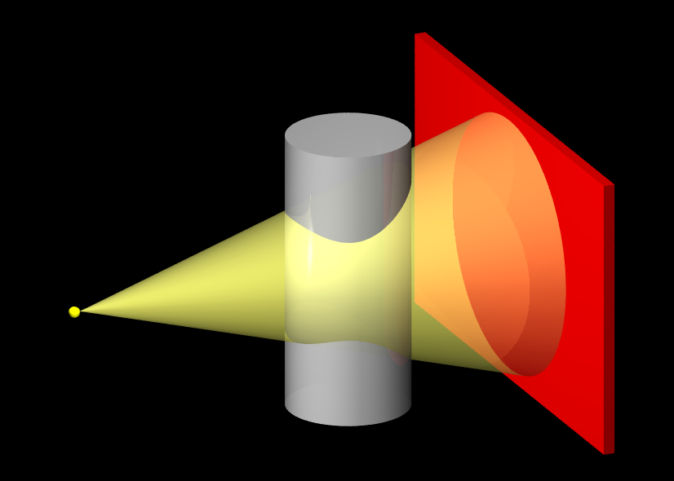
CT – Cone beam

Slide 54
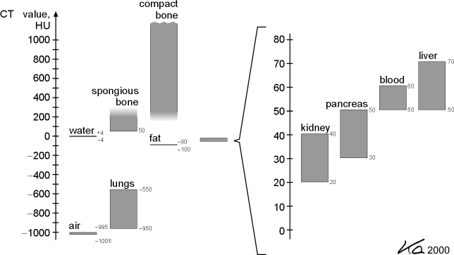
CT – Hounsfield unit

Slide 55
“The most important slides”

